Slide 1
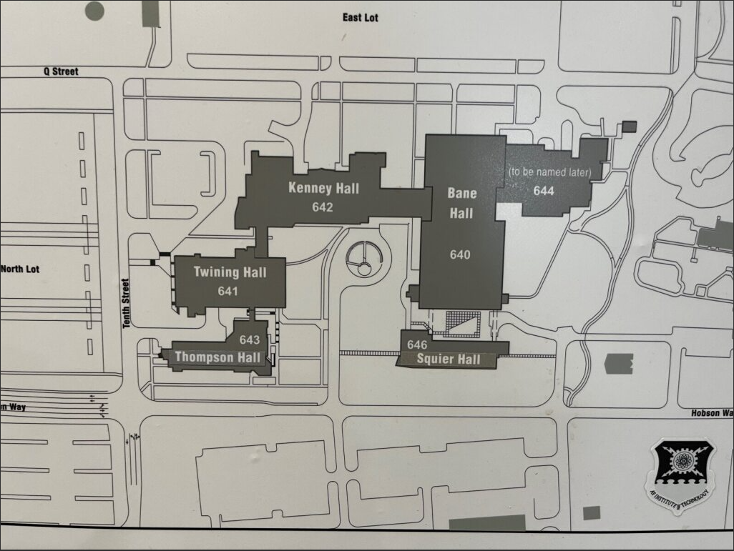
AFIT MAP
1st Annual DMM Symposium
Event Parking
USE ENTRANCE BY DUNKIN DONUTS
Primary Location
Address: 2950 Hobson Way, Wright-Patterson AFB, OH 45433
Secondary Location – Johnson Auditorium
**Signs will be in place to direct you to DMM Symposium locations**

